Slide 1
Mineral Tester
Quinn Nimmer
Mike Schommer
Rick Bowman
Seth Frevert

Slide 2
Description
An app that helps students practice mineral identification
Numerous tests to identify minerals
Scratch test, HCL acid test, magnetism, etc.
Teaching Tool
Professor could create questions/assignments around mineral identification
Students would practice/study these questions
Why?
Not everyone has access to these minerals
Certain amount of lab time
Pandemic made lab courses more difficult to teach

Slide 3
Audience
For Professors
Still have lab lectures when class can’t be held
Could be apart of some labs
For Students
Used by students during pandemic
Possible study guide

Slide 4
Professor User Stories
As a professor, I want to be able to create student logins, so that I can control which students have access to the application
As a professor, I want to be able to delete student accounts, so students that drop my class won’t be able to access the application
As a professor, I want to be able to create other faculty accounts, so that I can have assistant professors or teaching assistants make sample questions and input mineral data
As a professor, I want to be able to delete other faculty accounts, so I can manage access to administrative actions

Slide 5
Professor User Stories
As a professor, I want to be able to store mineral information, their properties, and the results of different identification tests, so that I can prepare practice problems for students
As a professor, I want to be able to post practice problems for students, so they can get curated practice

Slide 6
Student User Stories
As a student, I want to be able to login to the application, so that I can practice different mineral tests on various types of minerals
As a student, I need a way to see questions prepared by the professor, so that I can attempt to answer them

Slide 7
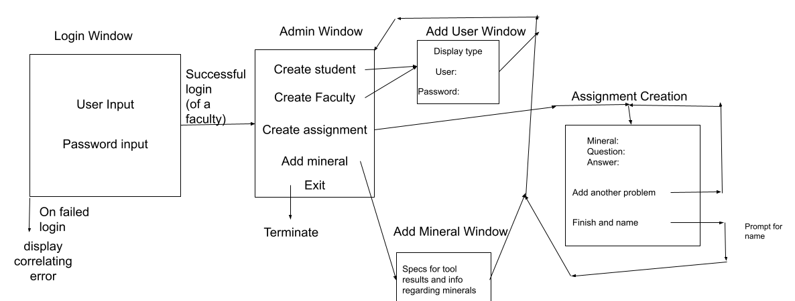
UI (main window and faculty side)

Slide 8
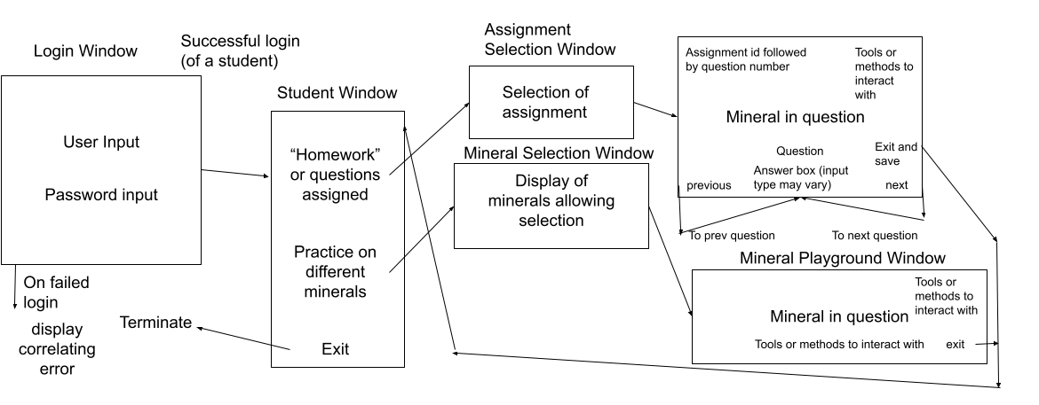
UI (main window and Student side)

Slide 9
Questions?

